Slide 1
Circuit programming models for GPUs
Vladimir Maksimovski, with much help from professor Pai

Slide 2
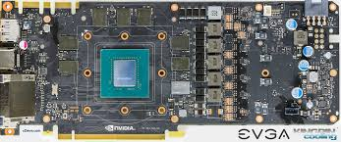
Why are GPUs useful
I’ll focus on NVIDIA Geforce 1080. Similar numbers for all NVIDIA GPUs.
GPUs are specialized for graphics processing.
This also makes them very good at SIMT (single instruction, multiple thread) operations.

Slide 3
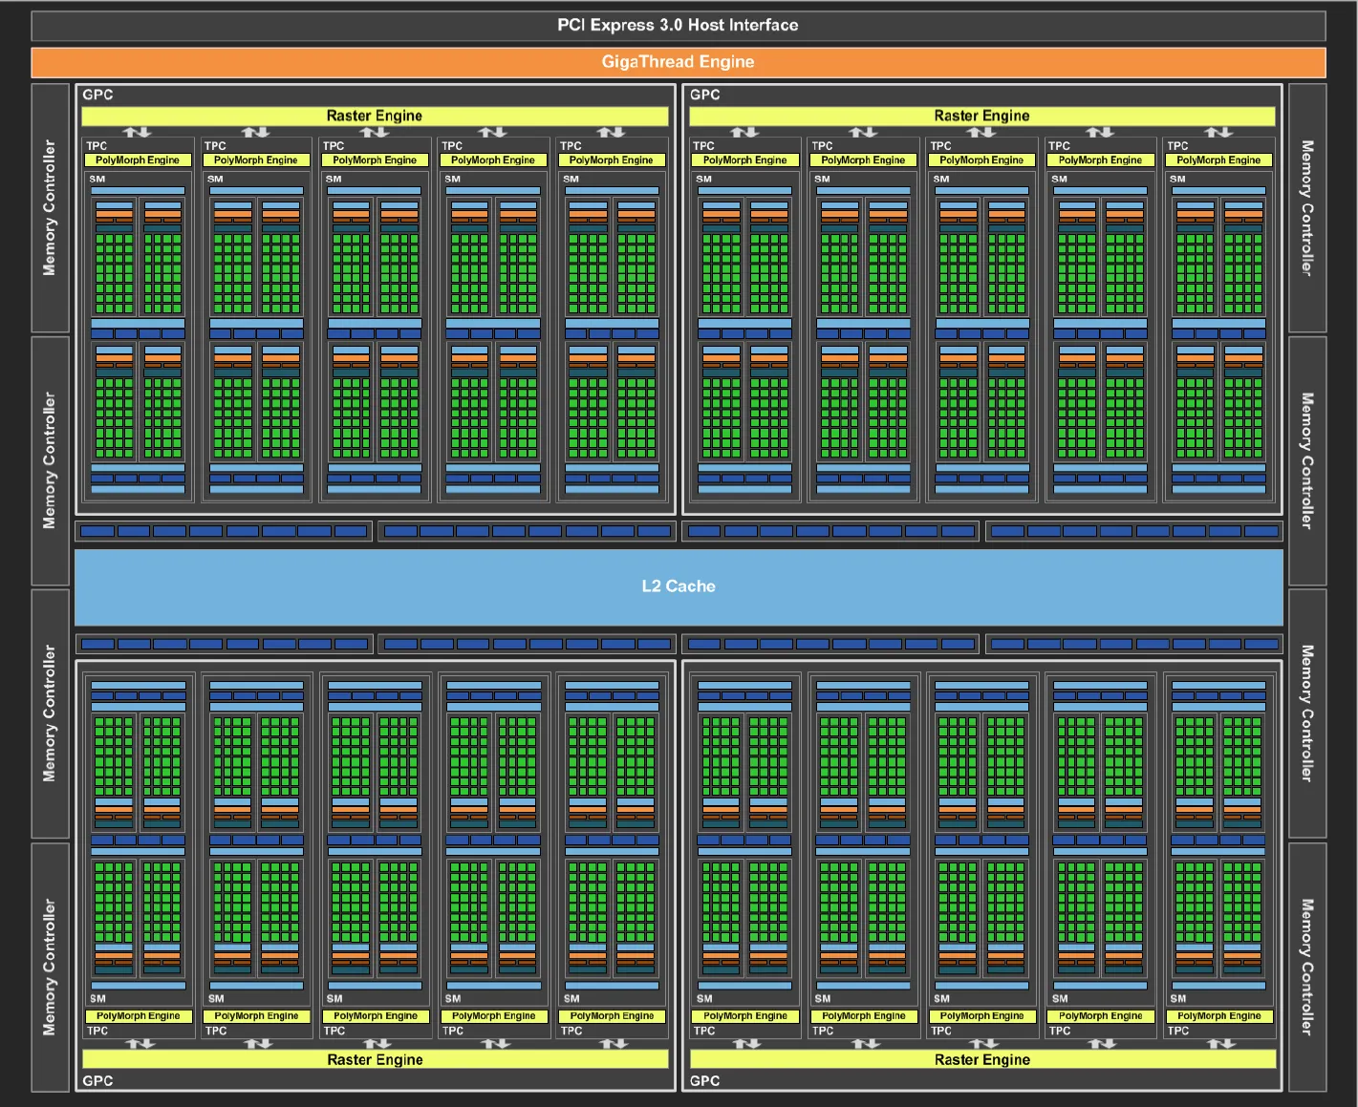
What’s inside a GPU (that SIMT operations care about)
Video Ram (8 GB for Geforce 1080).
Bus interface (320 GB/s for Geforce 1080).
Many SMs (streaming multiprocessors) (20 for Geforce 1080).
128 CUDA cores per SM
marketing speak for an ALU (FP/INT).
96KB (on-chip!!) shared memory per SM.

Slide 4
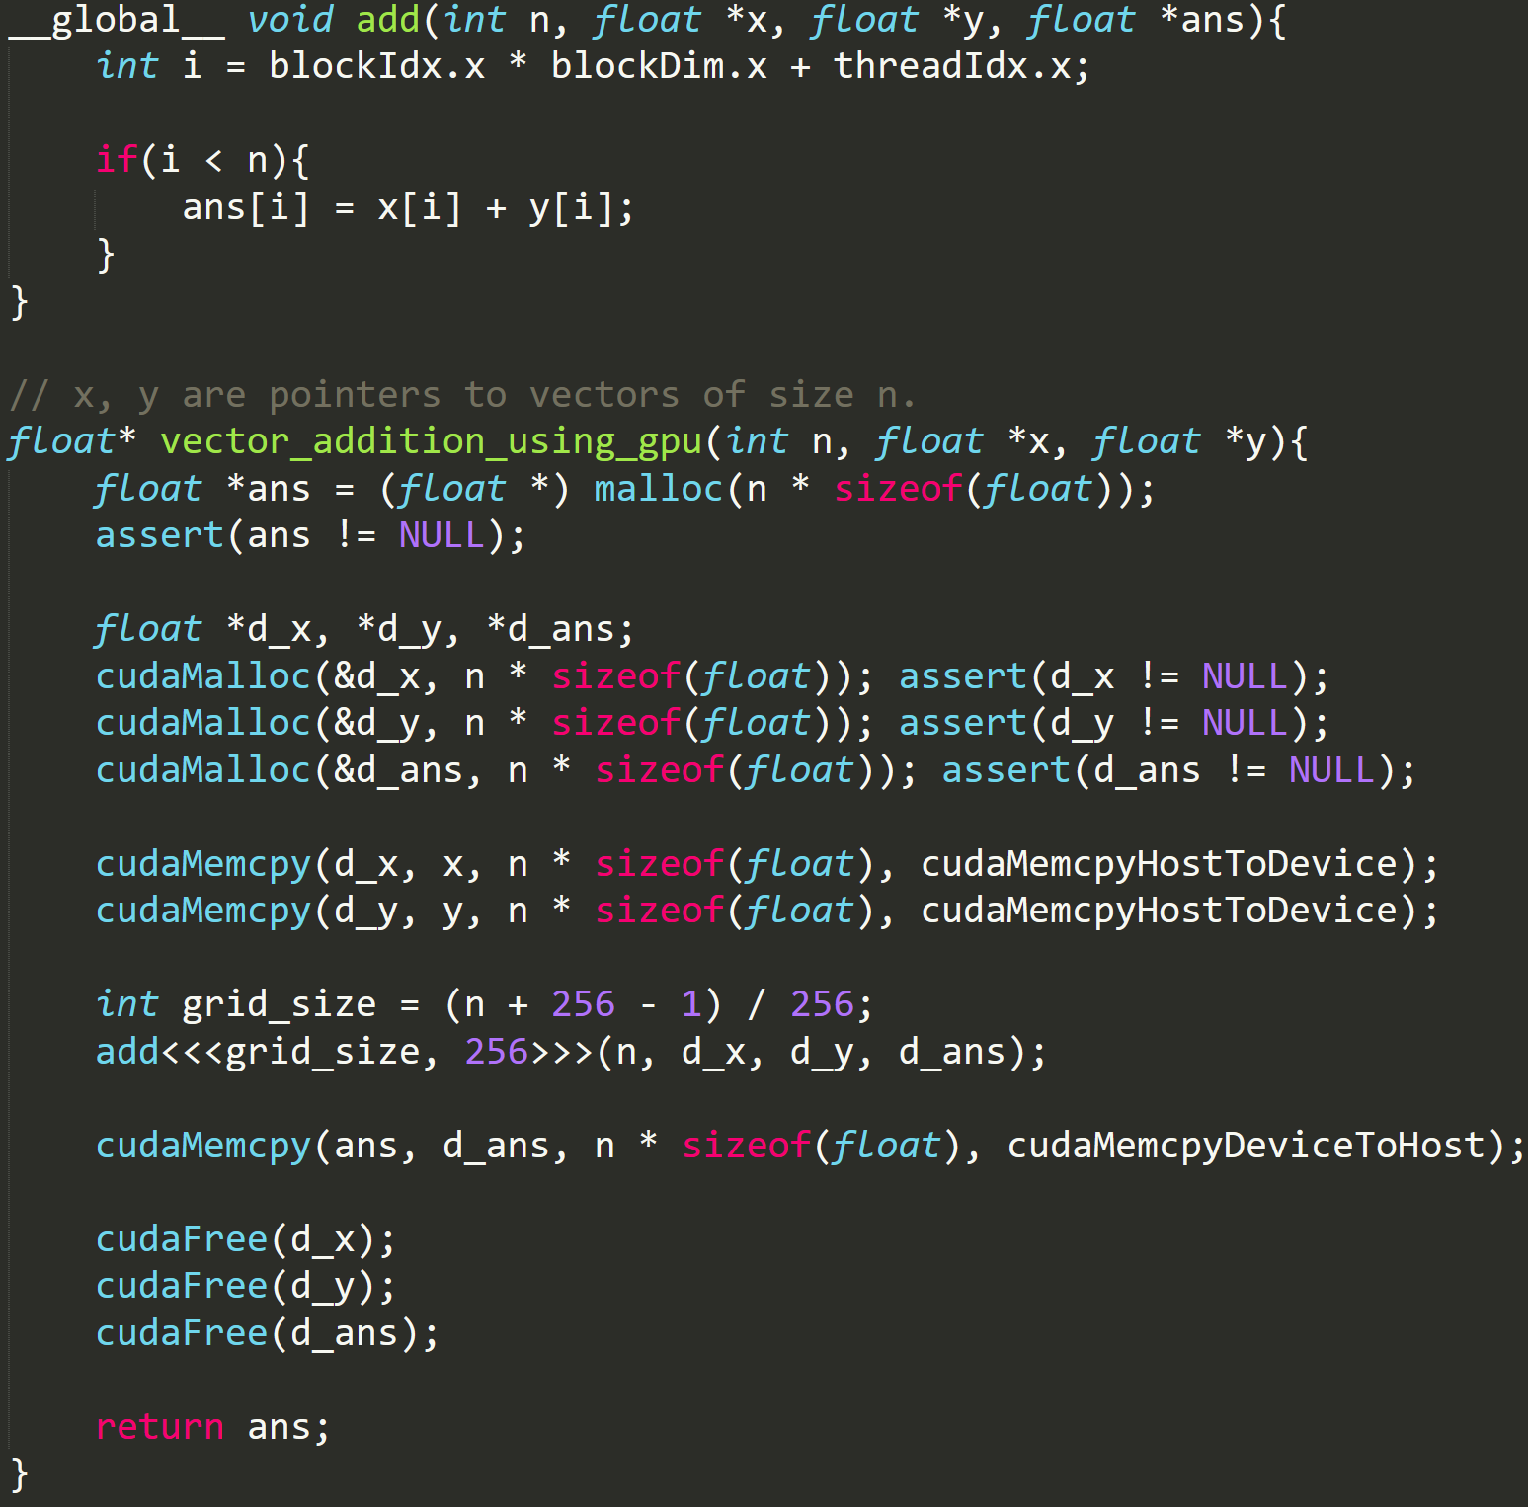
CUDA coding abstractions
CUDA makes C++ to GPU easy.
Programmer creates a kernel.
Specifies #thread blocks, #threads.
Thread blocks are independent, no shared memory.
Threads can get shared memory, can synchronize.
SM takes a thread block, executes it.
SM splits this into 32-wide warps.
Warps are executed concurrently.
Memory allocation using cudaMalloc().

Slide 5
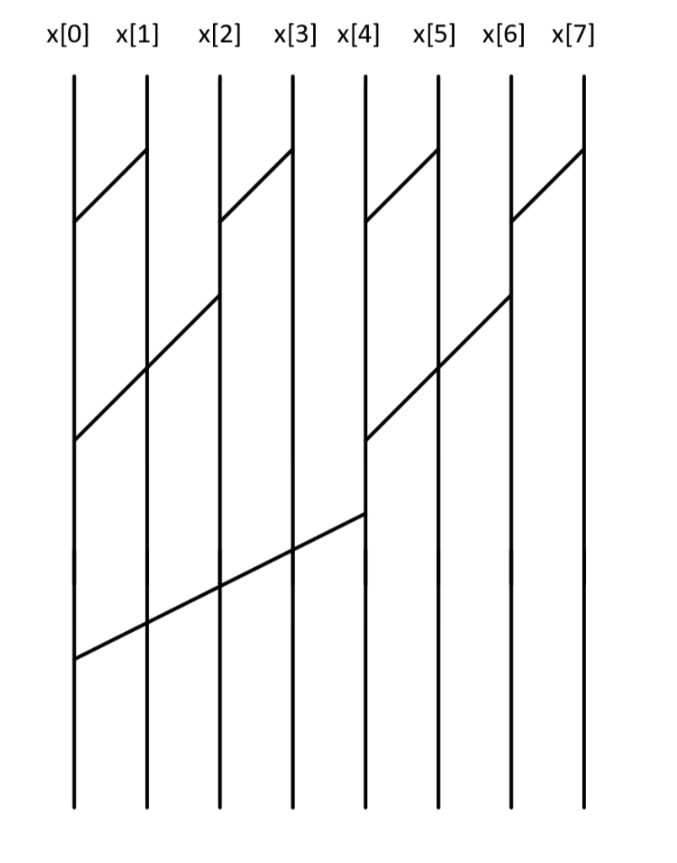
Okay, so what’s up?
C, C++, Fortran are designed for CPUs, not GPUs.
Expressing GPU code in C++ hides a lot of the structure in favor of bit tricks.
Consider computational circuits (reduce shown here).
Input connects to output via circuit lines.
Operation is a function of multiple lines.
Operation written back to a single line.
Using induction rules, circuits can be expressed easily.

Slide 6
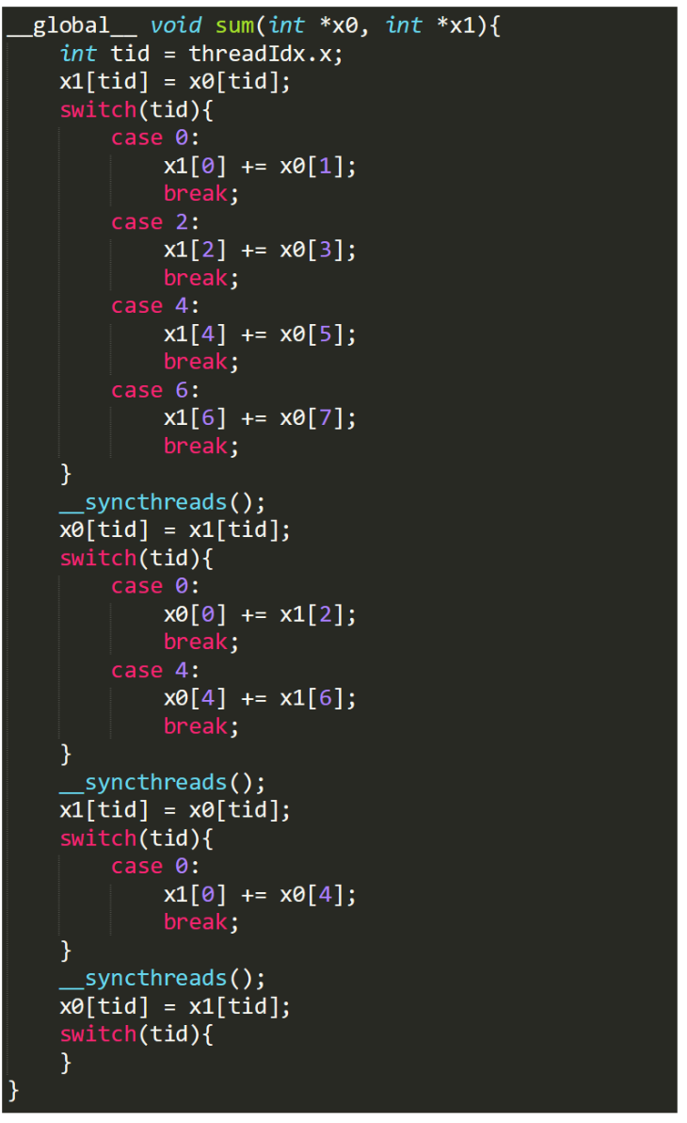
Current work
Created a proof-of-concept circuit-to-cuda compiler using custom format.
Limitations:
Assumes fixed circuit size.
Barriers after each step.
2*n memory usage.

Slide 7
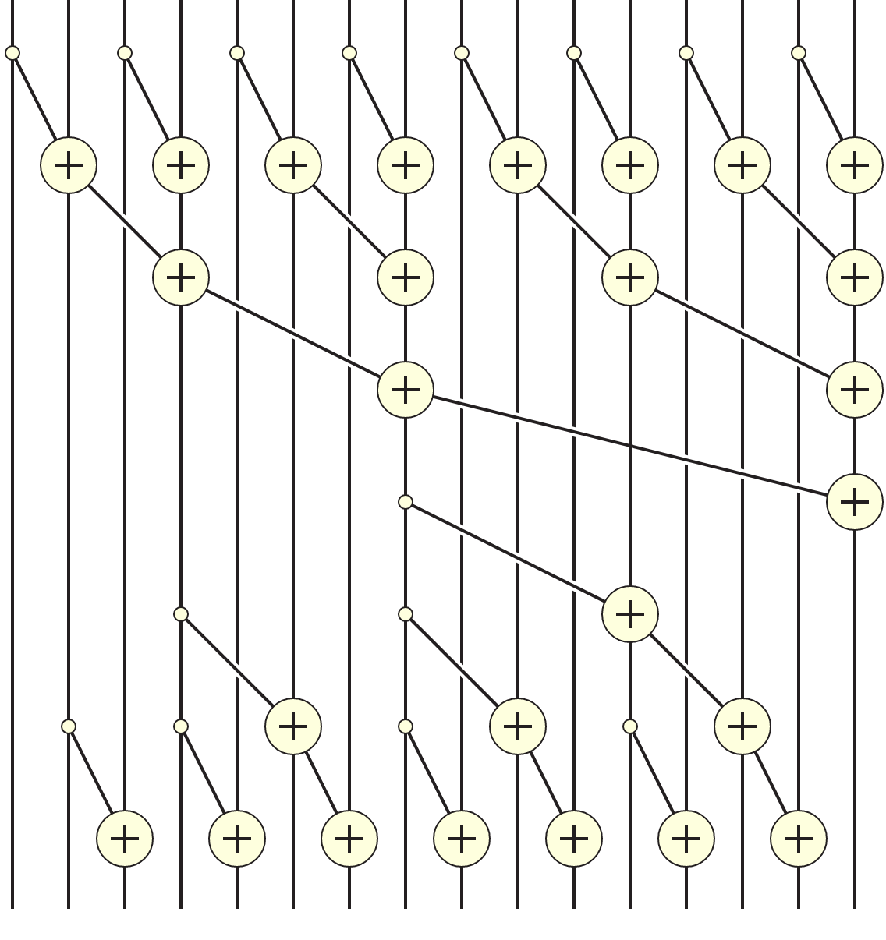
Optimizations feasibility pt.1
Prefix sum takes in an array, and returns the prefix sum for all elements.
Wrote this in CUDA manually. 34.40 GBPS
Each thread block computes its prefix scan using ->
Previous thread blocks aren’t included in the sum!
Prefix scan on thread block sums
Propagate the thread-block-sums to each thread.

Slide 8
Optimizations feasibility pt.2
Prefix sum takes in an array, and returns the prefix sum for all elements.
Wrote this in CUDA manually. 34.40 GBPS
Each thread block computes its prefix scan using ->
Previous thread blocks aren’t included in the sum!
Prefix scan on thread block sums
Propagate the thread-block-sums to each thread.
Reduce thread divergence. 42.20 GBPS
Reduce shared memory contention. 50.23 GBPS

Slide 9
Future work
Consider what an inductive format would look like.
See how to algorithmically express these optimizations

Slide 10
Thanks for listening!
SELECT questions
FROM audience

